Slide 1

Sports Matchmaker
The ultimate pick-up game app

Slide 2
Sports Matchmaker
What is Sports Matchmaker?

Slide 3
Sports Matchmaker
What is Sports Matchmaker?

Slide 4
Sports Matchmaker
Past Assignments

Slide 5
Sports Matchmaker
Past Assignments

Slide 6
Sports Matchmaker
Features > Create Match

Slide 7
Sports Matchmaker
Features > Create Match

Slide 8
Sports Matchmaker
Features > Notification Service

Slide 9
Sports Matchmaker
Features > Notification Service

Slide 10
Sports Matchmaker
Features > Find Match

Slide 11
Sports Matchmaker
Features > Find Match

Slide 12
Sports Matchmaker
Features > Match Schedule

Slide 13
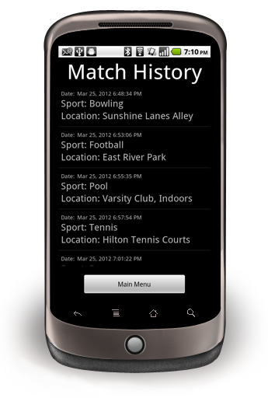
Sports Matchmaker
Features > Match Schedule
How it works
  A schedule of joined or created games are kept in a Match Schedule until the game becomes expired.
  Games are marked as expired when the Match Leader ends the game or the game
  As long as the game is not expired, the user will be able to see the details of their created or joined match from the main menu
Technical Details
  Technology Used: SQLite
  Custom List

Slide 14
Sports Matchmaker
Features > Match History

Slide 15
Sports Matchmaker
Features > Match History

Slide 16
Sports Matchmaker
Demonstration Time!!!

